Slide 1
Pneumothorax Segmentation
UNIMORE
DEEPHEALTH 2ND HACKATON
21 May 2020

Slide 2
Pneumothorax Segmentation
SIIM-ACR Pneumothorax Segmentation is a Kaggle challenge which aims to identify Pneumothorax disease in chest x-rays.
The use_case_pipeline GitHub repository contains two scripts for training and test a deep neural network for such a challenge (of course using ECVL and EDDL).
In this presentation we will provide a description of:
Model architecture employed
Training/validation splits
Augmentations chosen

Slide 3
SegNet Architecture
Model presented in 2015 (pdf) for semantic segmentation
Encoder-decoder network
Final pixelwise classification layer

Slide 4
Architecture
The encoder network consists of 13 convolutional layers (first 13 convolutional layers of VGG16 network)
The appropriate decoder in the decoder network upsamples its input producing sparse feature maps. These feature maps are then convolved with a trainable decoder filter bank to produce dense feature maps.
The high dimensional feature representation at the output of the final decoder is fed to a trainable soft-max classifier.

Slide 5
SegNet Architecture with EDDL
https://github.com/deephealthproject/use_case_pipeline
input3
conv1 bn1 relu1
conv2 bn2 relu2
maxpool2
conv3 bn3 relu3
conv4 bn4 relu4
maxpool4
conv5 bn5 relu5
conv6 bn6 relu6
conv7 bn7 relu7
maxpool6
conv8 bn8 relu8
conv9 bn9 relu9
conv10 bn10 relu10
maxpool8
conv11 bn11 relu11
conv12 bn12 relu12
conv13 bn13 relu13
maxpool10
upsampling1
conv14 bn14 relu14
conv15 bn15 relu15
conv16 bn16 relu16
upsampling2
conv17 bn17 relu17
conv18 bn18 relu18
conv19 bn19 relu19
upsampling3
conv20 bn20 relu20
conv21 bn21 relu21
conv22 bn22 relu22
upsampling4
conv23 bn23 relu23
conv24 bn24 relu24
upsampling5
conv25 bn25 relu25
conv26 bn26 relu126
sigmoid1

Slide 6
Pneumothorax dataset
The original dataset consists of 12,047 images for training and 3,205 for test without a provided ground truth.
Only 2,669/12,047 actually had a pneumothorax and therefore a ground truth mask, for the others a completely black mask is used.
The last 200 images of these 2,669 were chosen to be used in the validation set.
Given the high unbalance, training and validation splits have been created with 80% of images with ground truth mask and 20% of those without mask.
YAML and More
https://github.com/deephealthproject/use_case_pipeline/#pneumothorax

Slide 7
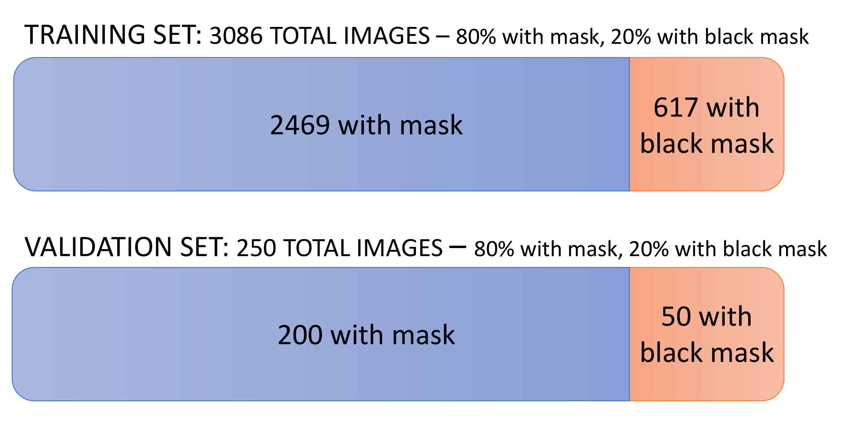
Summing Up

Slide 8
Black ground truth balancing
The validation images are always fed to the network with the same order. For this reason, after obtaining the ordered list of images without the mask, the last 50 are always selected for the validation set.
For training, on the other hand, images without mask are randomly chosen at each call of the PneumothoraxLoadBatch function from the list of all 9,328 unmasked images left, until the maximum number of 617 black images is reached.

Slide 9
Pneumothorax Augmentations
ECVL offers Augmentation since version v0.1.1 and allows to easily combine them together.
The augmentations used for training Pneumothorax are:
auto training_augs = make_unique<SequentialAugmentationContainer>( AugResizeDim({512, 512}, InterpolationType::nearest), AugMirror(.5), AugRotate({ -10, 10 }), AugBrightness({ 0, 30 }), AugGammaContrast({ 0,3 }));

Slide 10
Resize
auto training_augs = make_unique<SequentialAugmentationContainer>( AugResizeDim({512, 512}, InterpolationType::nearest), AugMirror(.5), AugRotate({ -10, 10 }), AugBrightness({ 0, 30 }), AugGammaContrast({ 0,3 }));
Resize the input image to 512x512.

Slide 11
Mirror
auto training_augs = make_unique<SequentialAugmentationContainer>( AugResizeDim({512, 512}, InterpolationType::nearest), AugMirror(.5), AugRotate({ -10, 10 }), AugBrightness({ 0, 30 }), AugGammaContrast({ 0,3 }));
Randomly mirror the image with probability 0.5.

Slide 12
Rotate
auto training_augs = make_unique<SequentialAugmentationContainer>( AugResizeDim({512, 512}, InterpolationType::nearest), AugMirror(.5), AugRotate({ -10, 10 }), AugBrightness({ 0, 30 }), AugGammaContrast({ 0,3 }));
Randomly rotate the image with angle ranges from -10 to 10 degrees.

Slide 13
Brightness
auto training_augs = make_unique<SequentialAugmentationContainer>( AugResizeDim({512, 512}, InterpolationType::nearest), AugMirror(.5), AugRotate({ -10, 10 }), AugBrightness({ 0, 30 }), AugGammaContrast({ 0,3 }));
Add brightness with a random value in [0,30].

Slide 14
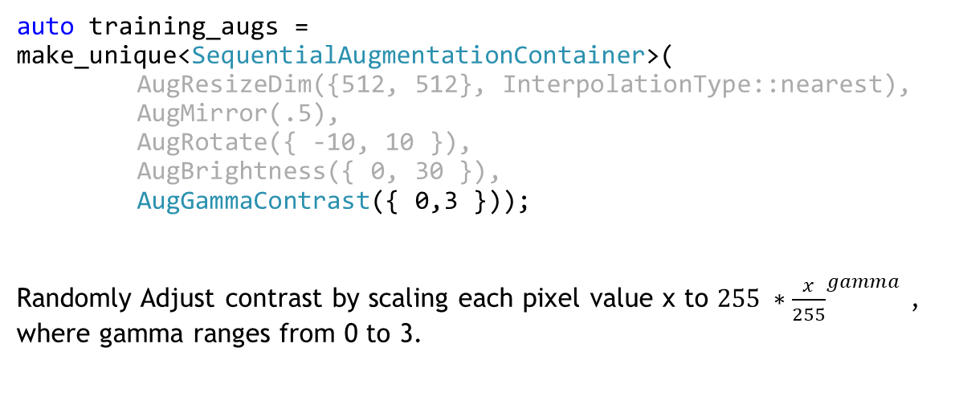
Gamma Contrast
auto training_augs = make_unique<SequentialAugmentationContainer>( AugResizeDim({512, 512}, InterpolationType::nearest), AugMirror(.5), AugRotate({ -10, 10 }), AugBrightness({ 0, 30 }), AugGammaContrast({ 0,3 }));
Randomly Adjust contrast by scaling each pixel value x to ${255 ∗\frac{x}{255}}^{gamma}$ , where gamma ranges from 0 to 3.

Slide 15
Pneumothorax Augmentations
The augmentation of validation is:
auto validation_augs = make_unique<SequentialAugmentationContainer>( AugResizeDim({512, 512}, InterpolationType::nearest) );
Which only resize the validation images to 512x512.

Slide 16
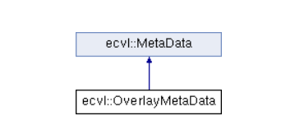
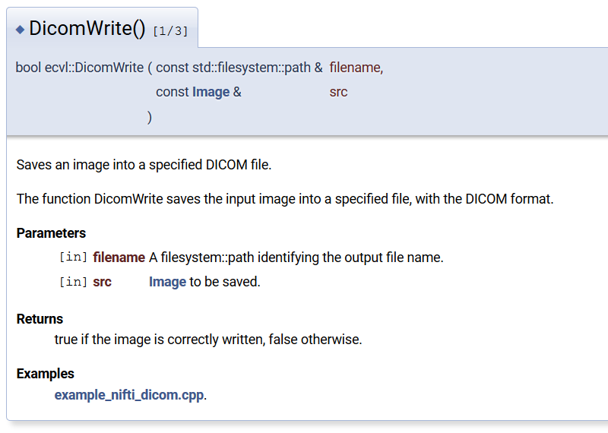
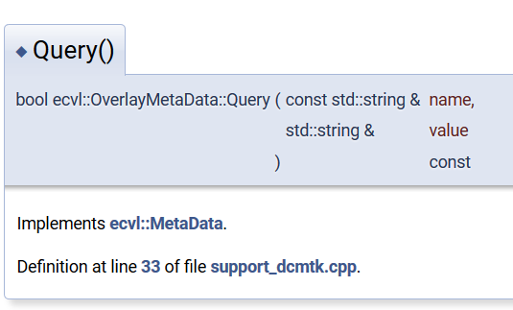
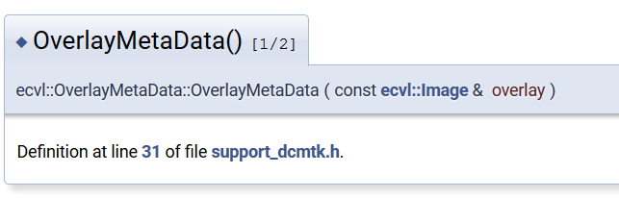
DICOM Overlay with ECVL

Slide 17
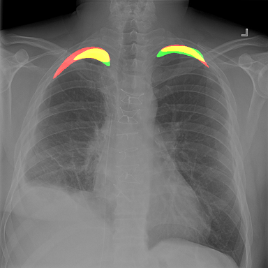
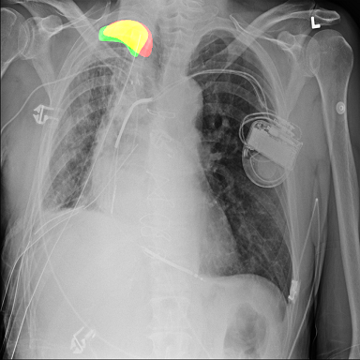
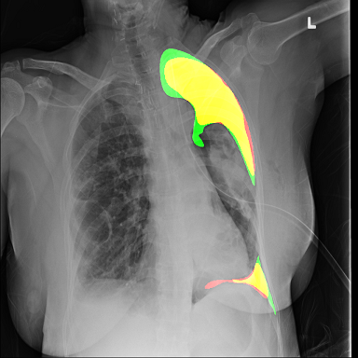
DICOM Overlay with ECVL
Green is ground truth, red is prediction, and yellow are the correctly predicted pixels.

Slide 18
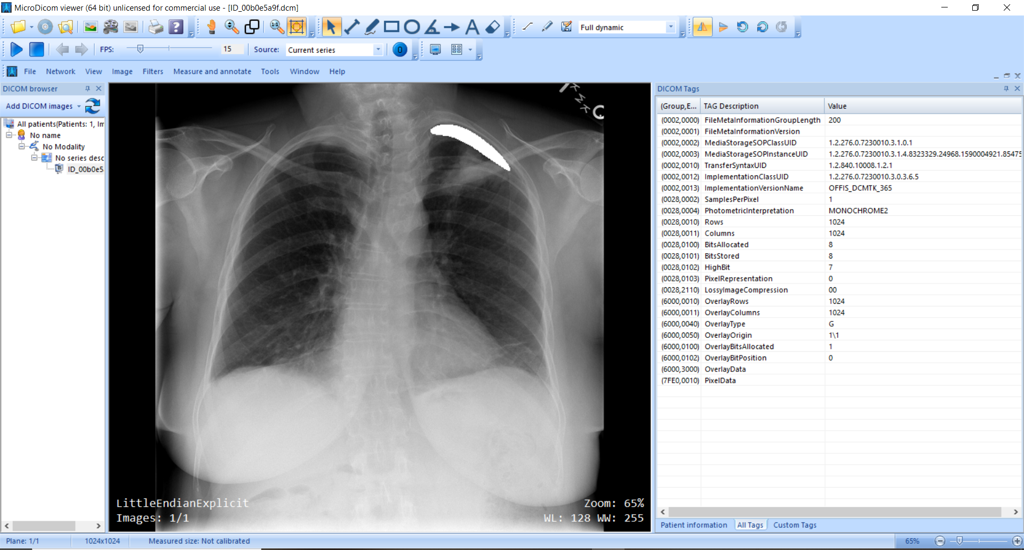
DICOM Overlay with ECVL

Slide 19
Python Pneumothorax
The Pneumothorax training and inference examples have been also ported to PyECVL and PyEDDL → Link
The same network, dataset splits, and augmentations are employed.
Moreover, if you are a PyTorch fan, the use_case_pipeline repository includes scripts for creating dataloaders from the DeepHealth dataset YAML files.

Slide 20
Now it's your turn!
Costantino Grana
costantino.grana@unimore.it

